Slide 1

Department of Computer Science &Engineering Artificial Intelligence & Machine Learning A.P. Shah Institute of Technology G.B.Road,Kasarvadavli, Thane(W), Mumbai-400615 UNIVERSITY OF MUMBAI Academic Year 2022-2023

Slide 2

Brain Tumor Detection
Computer Science & Engineering
Artificial Intelligence and Machine Learning
By
Mihir Manjrekar (21106027)
Rohit Negi(21106053)
Shubham Singh (21106030)
Nehali Palkar(21106057)
Under the Guidance of
Dr. Jaya Gupta

Slide 3

Index
Introduction
Objectives
Features
Literature survey
Block Diagram
Tools/Softwares, Languages used
Conclusion
References

Slide 4
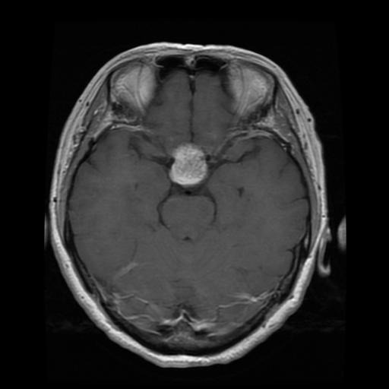
Introduction
One of the most rigorous disease
A key concern for the radiologist
A Stereotactic Biopsy Test
Many risk factors is involved in the biopsy test.
Stereotactic Biopsy is not 100% accurate
Result in diagnostic error.

Slide 5
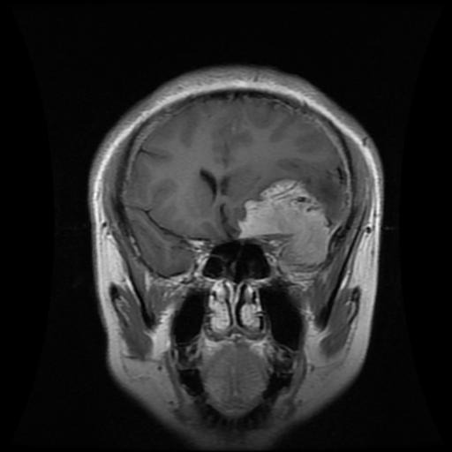

Objective
To provide doctors good software
To save patient’s time.
To provide a solution appropriately at early stages.
To get timely consultation.
To identify tumor and their causes.

Slide 6
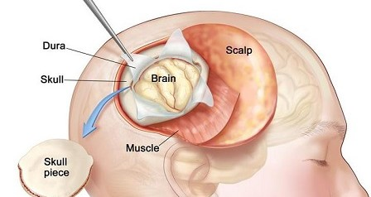
Current Challenges in Brain Tumour Detection
The current methods of brain tumour detection are not always accurate.
Doctors often rely on imaging tests such as MRI and CT scans, which can be expensive.
Additionally, these tests may not always provide clear results, making it difficult for doctors to determine whether a patient has a tumour or not.
Another challenge in brain tumour detection is the variability of tumours. Each tumour is unique, and they can appear in different locations within the brain.
This makes it difficult for doctors to develop a universal method for detecting tumours.

Slide 7
Literature Survey
Sr. No | Title | Author Name | Description
1. | Categorizing and Reviewing the current progress on transfer learning for classification, regression and clustering problems^{[1]} | Pan & Yang 2010 | Relationship between transfer learning And other related machine learning techniques
2. | Image classification based on transfer learning solutions^{[2]} | Krizhevsky et al. 2012 | Achieved results in image classification, To classify the 1.2 million high-resolution images in the ImageNet LSVRC-2010 contest into the 1000 different classes.

Slide 8
Literature Survey
Sr. No | Title | Author Name | Description
3. | The Effect of the Convolutional Network Depth on its accuracy in the large-scale image recognition^{[3]}. | Simonyan& Zisserman 2014 | Evaluation of networks of increasing depth. Using every small convolution filters.
4. | A Deep Convolutional Neural Network Architecture Codenamed Inception^{[4]} | Szegedyet al.2015 | To set the new state for classification and detection in the ImageNet Large-Scale Visual Recognition Challenge 2014(ILSVRC14).

Slide 9
Sr. No | Title | Author Name | Description
5. | Image Segmentation by Clustering Methods: Volume 29– No.11 ^{[5]} | B.Sathya and R.Manavalan , September 2011 | To provide a different clustering algorithm Presented an experimental analysis for massive datasets consisting of unique photographs.

Slide 10
BLOCK DIAGRAM

Slide 11
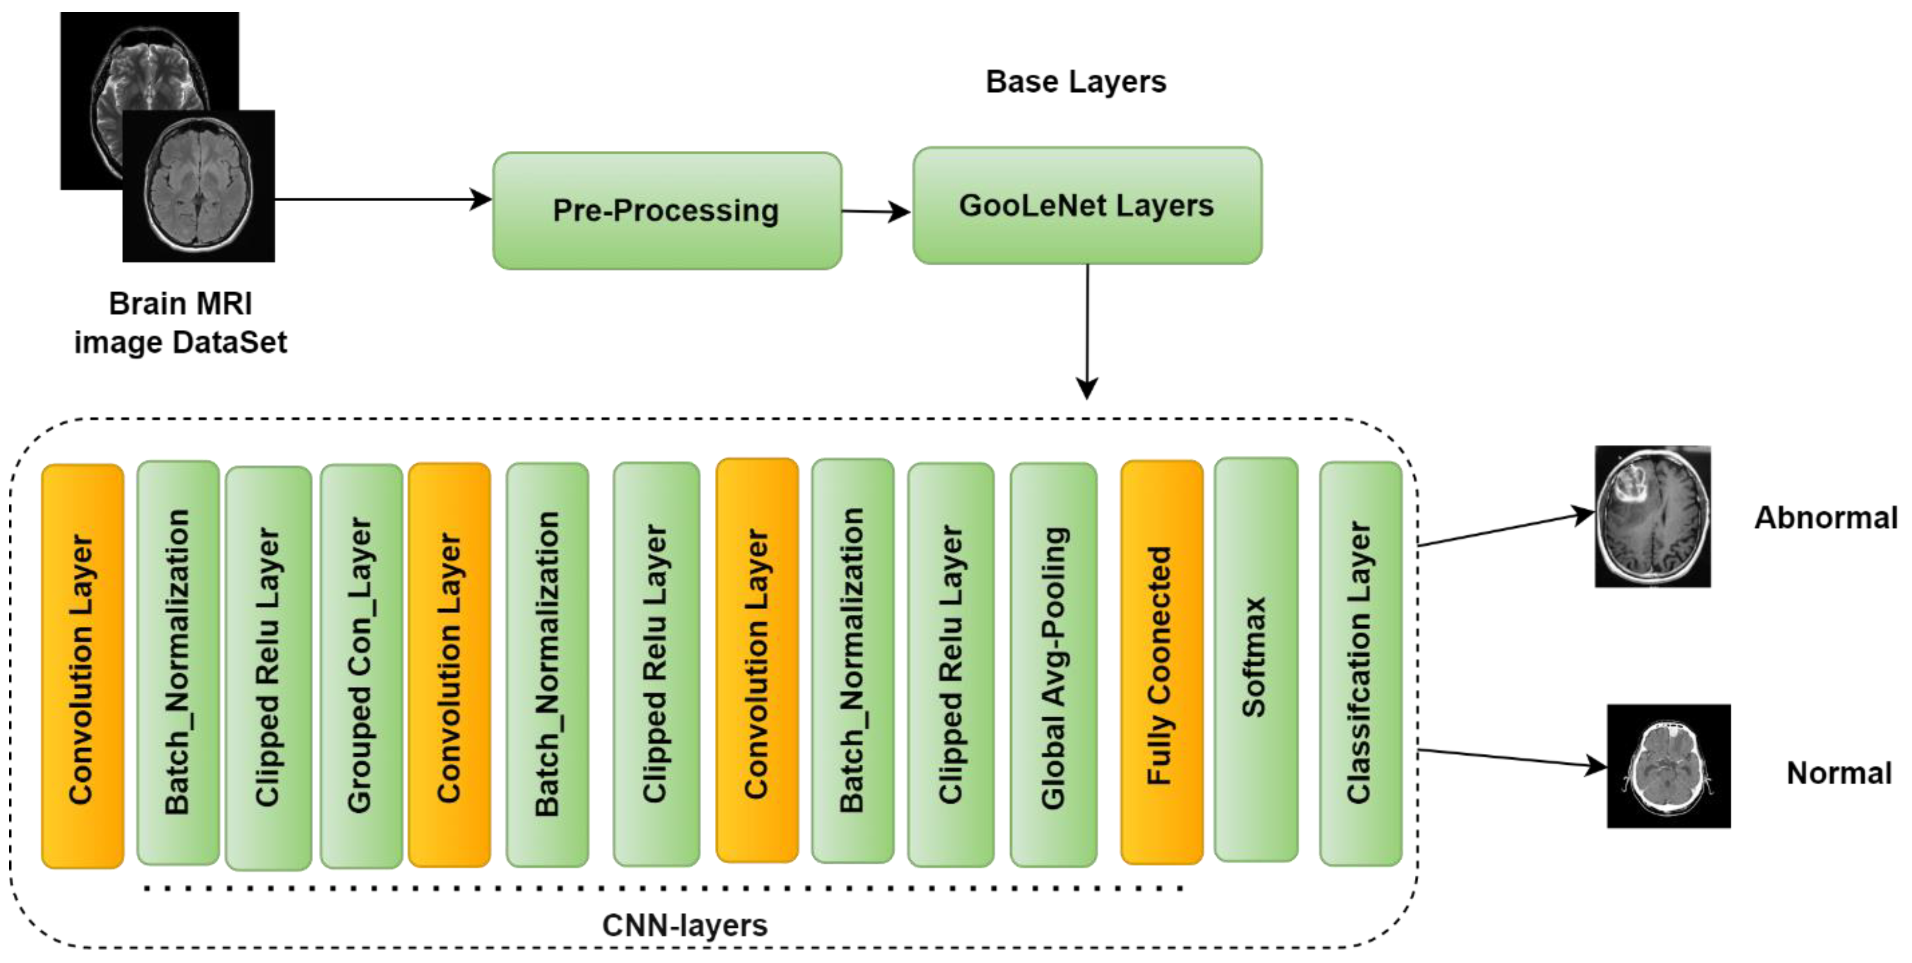

Slide 12
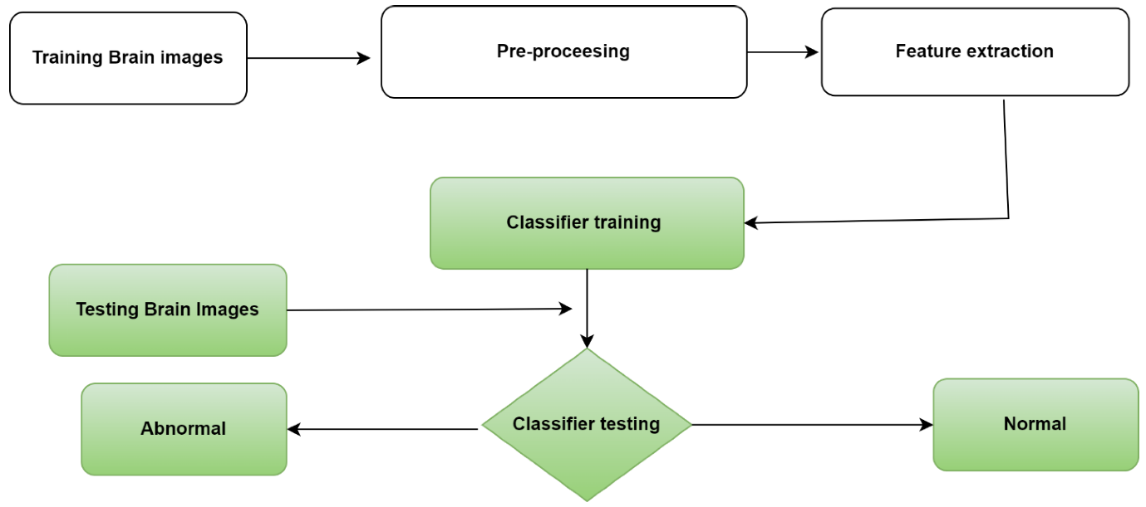

Slide 13





Tools/Software's, Languages used
Python
Kaggle
Visual Studio Code
Google Colaboratory
Stream Lit

Slide 14
PROJECT WORK

Slide 15
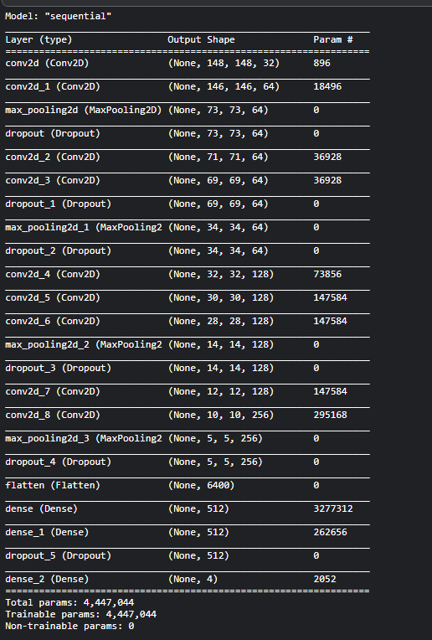

Slide 16
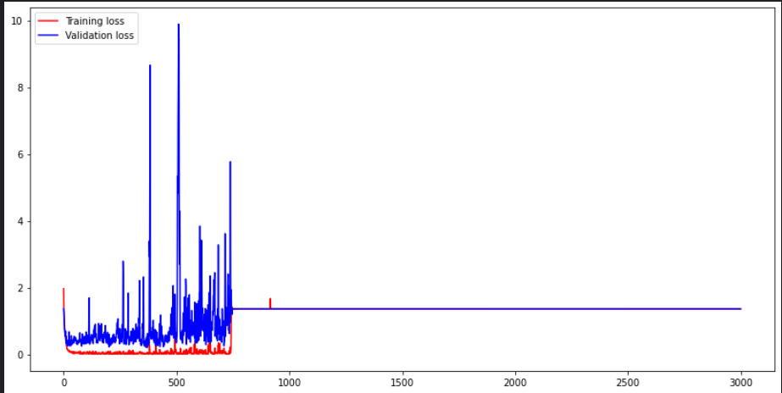

Slide 17
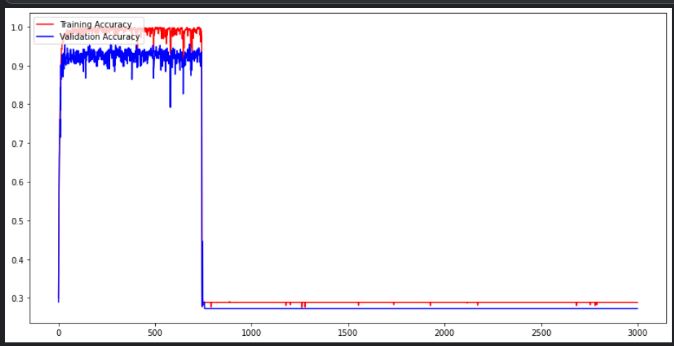

Slide 18
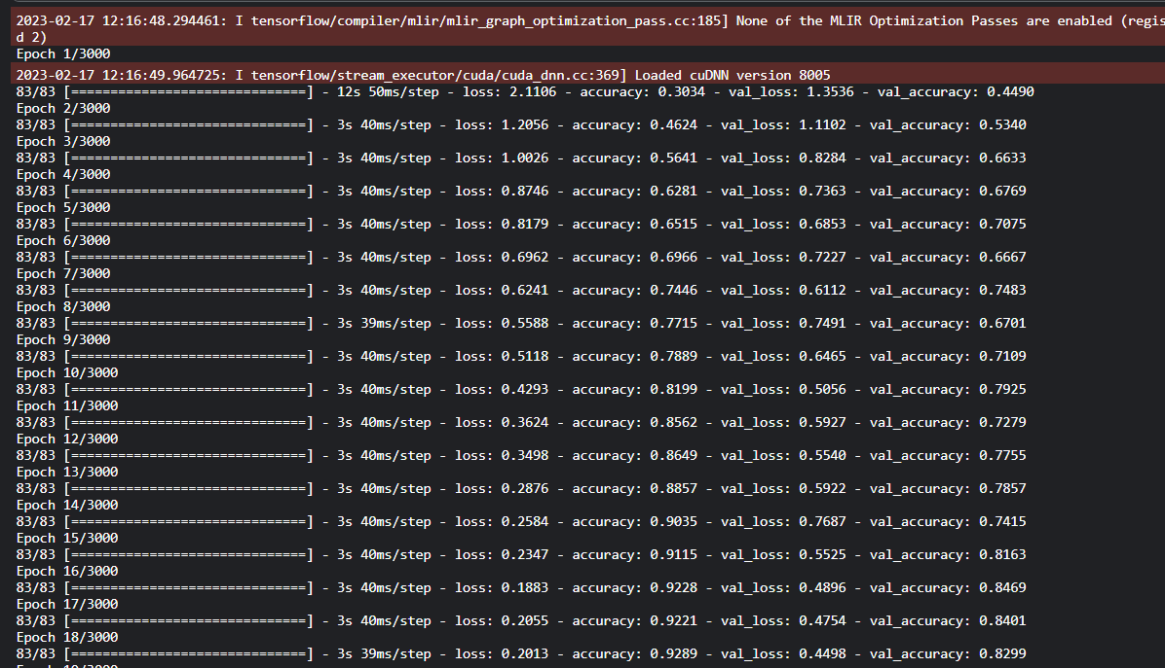

Slide 19
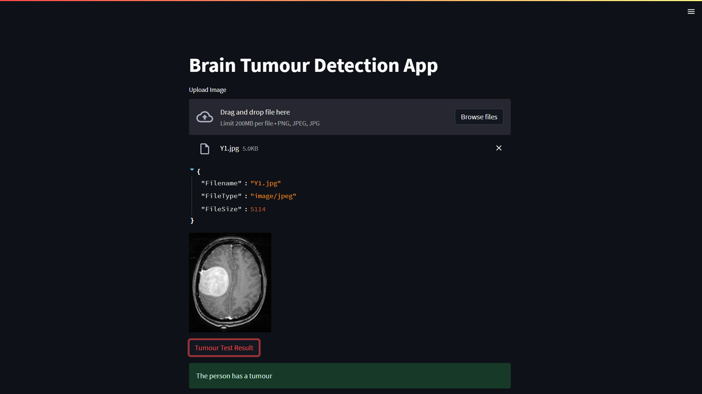

Slide 20

Conclusion
To create a model with high accuracy.
To check the performance of the model.
To predict just by reducing and resizing the image.
Not losing any important information.
Different datasets would be applied to this model.
To further increase the overall accuracy.

Slide 21
References
Journal Papers
[1] H. Mohsen, E.-S. A. El-Dahshan, E.-S. M. El-Horbaty and A.-B. M. Salem, “Classification using deep learning neural networks for brain tumors,” Future Computing and Informatics Journal, pp. 68-71, 2018.
[2] N. Abiwinanda, M. Hanif, S. T. Hesaputra, A. Handayani and T. R. Mengko, “Brain tumour classification using Convolutional Neural Network,” IFMBE Proceedings, pp. 183-189, 2018
[3] M. Huang, W. Yang, Y. Wu, J. Jiang, W. Chen and Q. Feng, “Brain tumor segmentation based on local independent projection-based classification,” IEEE Transactions on Biomedical Engineering, pp. 2633-2645, 2014.
[4] J. Seetha and S. S. Raja, “Brain tumor classification using Convolutional Neural Networks,” Biomedical and Pharmacology Journal, pp. 1457-1461, 2018.
[5] P. Gokila Brindha, M. Kavinraj, P. Manivasakam and P. Prasanth, “Brain tumor detection from MRI images using Deep Learning Techniques,” IOP Conference Series: Materials Science and Engineering, p. 012115, 2021.
Useful Links
[6] https://www.kaggle.com/code/shivamagarwal29/brain-tumor/data

Slide 22
FUTURE SCOPE
To create a model with a higher accuracy.
Reduce healthcare costs
Monitoring the performance of the model
Facilitate remote and accessible healthcare
Personalized reports to analyze the change in structure of the tumour
To predict just by reducing and resizing the image without losing any important information

Slide 23

Thank you

